Slide 1

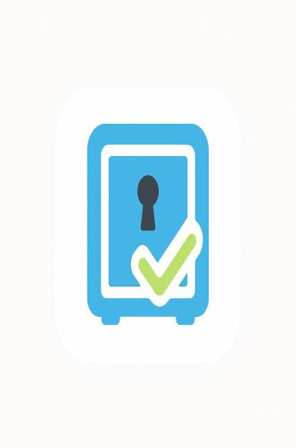
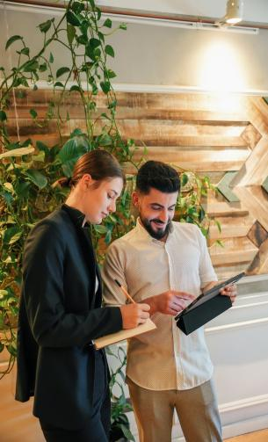


Store-Ease Smart Storage Solution
Presented By: Arooba Mansoor
M.Adil
M.Zain Shabbir
Instructor: Sir Raheel
Mentor: Sir Zunnurain

Slide 2
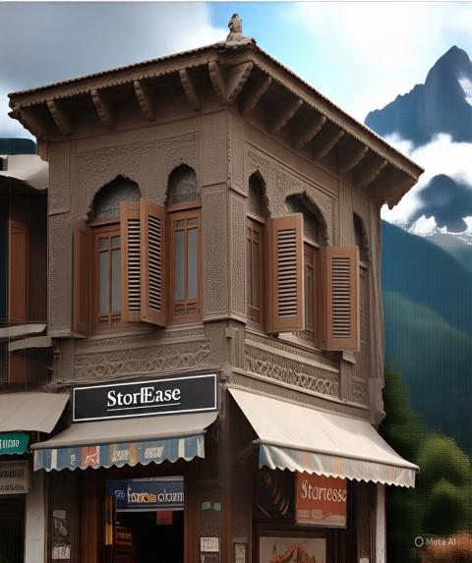
What is Store-Ease ?
An on-demand, app-based temporary storage solution.
Problem: People often lack secure, short-term storage options when they are in need of it.
How they face problem:
Students: No secure lockers on campus.
Hostelers: Must vacate hostels during breaks or pay for the even when they are at home.
Travelers: Need storage after hotel checkout.

Slide 3



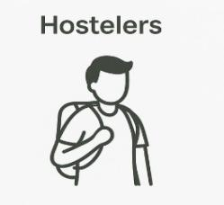
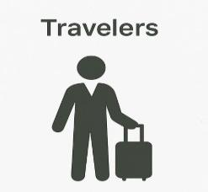
Target Audience
Target Audience #1
Target Audience #2
Target Audience #3
Need short-term, reliable storage between classes.
Monthly/semester storage during breaks.
Hourly luggage holding after checkout.

Slide 4





Value Proposition
All lockers are monitored and insured.
Customers feel safe keeping their belongings with us.
01
We offer multiple options: hourly, daily, or monthly storage.
Users choose what suits them best.
02
Lockers are placed in smart locations — near universities, hostels, and transport terminals.
Easy for users to find and use.
03
We’re starting at Bahria University, which has over 20,000 students.
A great place to launch and test our service.
04

Slide 5
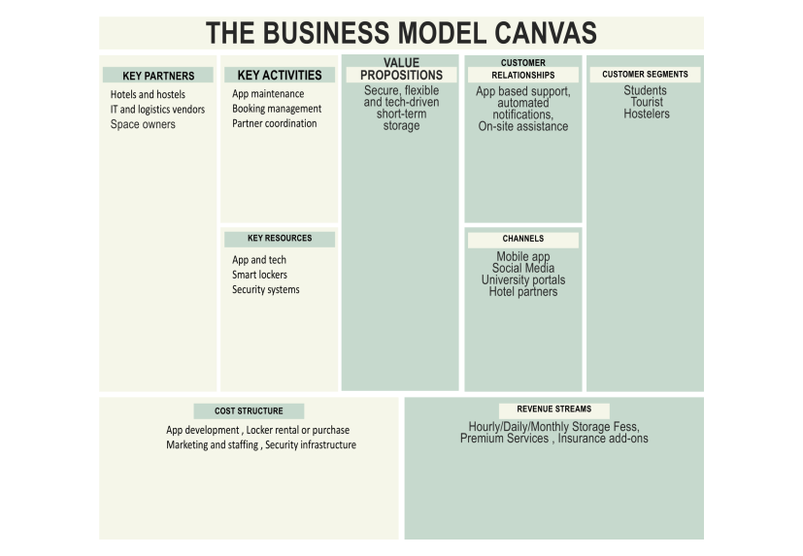

Slide 6

SWOT Analysis
Clarify the project's overall objectives and goals.
Strengths
Tech-driven, secure lockers, addressing to underserve segments
Weakness
Low brand awareness, Costly app development,Relies on 3rd party.
Opportunities
Immature market, high tech-driven gens
The market is still new — not many similar services exist
Threat
Copycat startups,institutional resistance.
Other startups may copy the idea

Slide 7

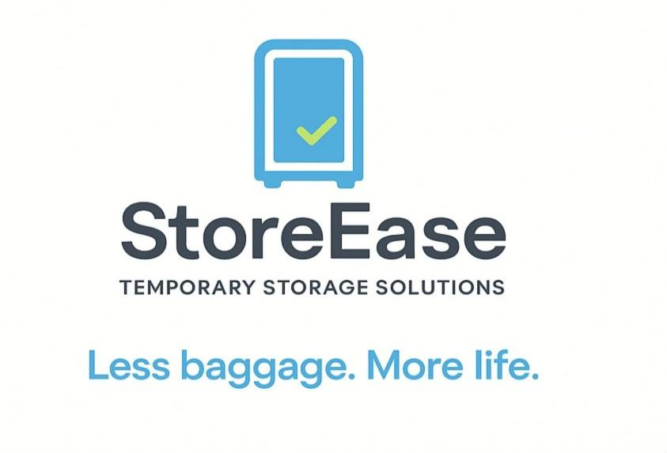

Slide 8

Marketing Strategy
Digital channels:
Facebook, Instagram, YouTube Shorts, SEO, and Email
Offline methods:
Flyers in universities, booths, and partnerships with hostels
We’re starting at Bahria University, which has over 20,000 students.
A great place to launch and test our service.

Slide 9
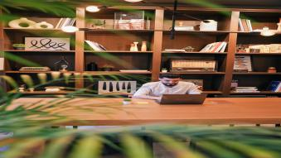


Book locker using the app
Get a QR code and drop off your items
Operational Process (How it Works)
Monitor anytime and pick them up when ready
Rate the service afterward

Slide 10
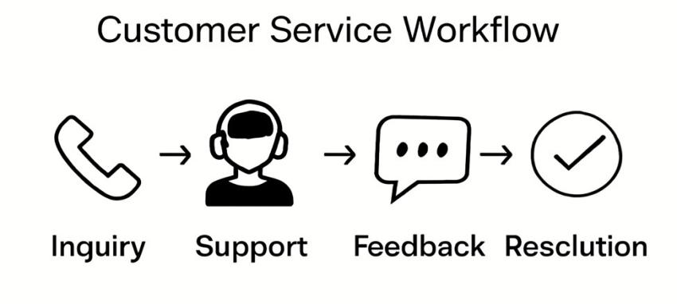
Customer Service Strategy

Slide 11
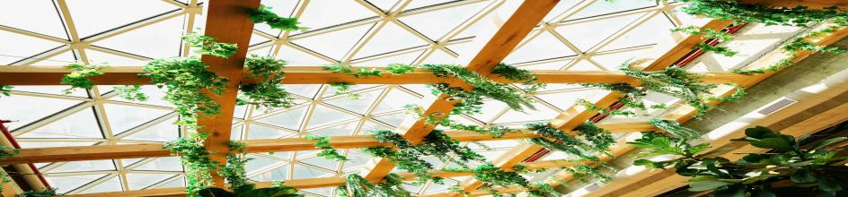



SUPPLY CHAIN
Introduce the who help us build and run StoreEase.
Suppliers
Partners
Support Team
Provide lockers, cameras, and IT services
Universities, hostels, hotels
Installs lockers and monitors remotely

Slide 12




Revenue Forecast (Year 1)
In our first year, we expect to earn money from five main sources:
Your We expect to earn from:
Hourly use (travelers): PKR 960K
Daily (students): PKR 900K
Monthly (hostelers): PKR 3.6M
Add-ons: PKR 900K
Commissions: PKR 1.2M
text
7.56 M
Total Expected Revenue

Slide 13
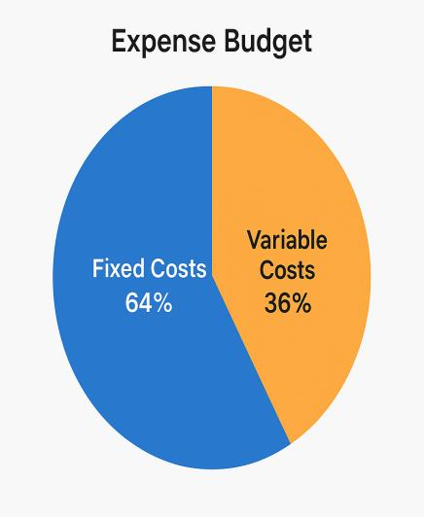
Expense Budget (Year 1)
Here is the pie chart showing StoreEase's Expense Budget for Year 1. It highlights the two main categories:
Fixed Costs (Salaries, Office, Cloud): 64%
Variable Costs (Marketing, Repairs): 36%
Total budget of PKR 11.68 million is going.

Slide 14

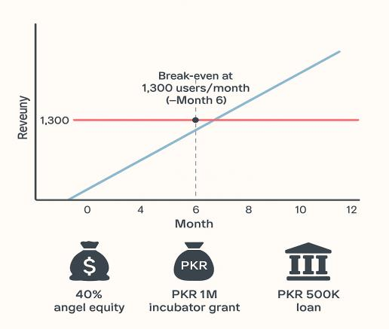
Break-Even Point
We will cover all our costs (no profit/loss) when we reach 1,300 users per month.
👉 This will likely happen by month
Funding Sources
To start and grow the business, we’ll get money from:
40% equity – From an angel investor (they get a share of the business)
PKR 1 million grant – From a startup incubator (free support money)
PKR 500,000 loan – Borrowed amount to be paid back

Slide 15
Risk & Growth Strategy
Identify We plan for risks and have a path to grow big.
Risk
Mitigations
Software bugs during peak usage
Use cloud auto-scaling + dev support SLA
Delay in Locker Suplly or repairs
Maintain Spare units in inventory for Quick swaps
Delivery bottlenecks in setup
Pre-schedule installation batches with location-specific crews

Slide 16
StoreEase
THANK YOU

